Slide 1
First Meeting:
Introduction

Slide 2

Nitzan Ofer 209706803
Danielle Eldor 324955145 Shir Bernstein 318155207
Scientific Papers Abstract Classification
Notes:
ליפות את המצגת

Slide 3
Problem Description and Motivation
Researchers reads a lot of papers for their research.
Explosion of published research: more than 4M new papers each year
Abstracts are primary gateway for discovery and indexing
Manual tagging is slow, costly, and inconsistent across venues

Slide 4
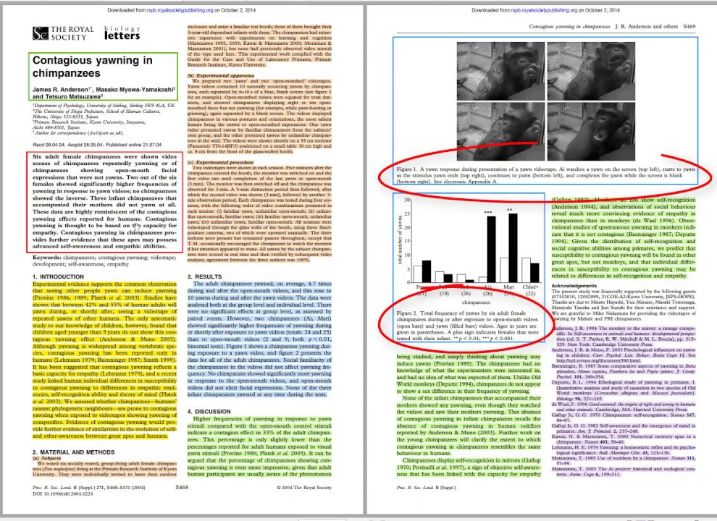
Papers Structure
Scientific papers generally include:
Title
Authors
Abstract
Introduction
Methods
Results
Conclusion.
We focus on the abstract, as it provides a concise summary of the paper's content and is often used for indexing and retrieval.
Notes:
זה הדבר שאמור לגרום לאחרים לעשות לכם swipe כמו בטינדר

Slide 5
Business Point Of View
The problem: 4M+ papers a year – manual abstract tagging is slow, costly, and inconsistent
The need: Automated domain and subdomain classification of papers (and even faster, abstracts)
Customers:
Digital libraries (IEEE, PubMed)
Universities and repositories
Academic publishers and editors
Research teams and recommendation systems
Contribution:
Reduced manual effort
Boost in retrieval accuracy
Enabling large-scale content organization

Slide 6
Data Description
Total Records: 46,985 scientific paper abstracts
Features:
Abstract: Full abstract text of each paper
Domain: Broad research field (e.g., CS, Medical) – 7 distinct values.
area: Specific sub-field or topic - 143 distinct values (we used 130).

Slide 7
Domain
Description | Domain | Label ID
Computer Science | CS | 0
Civil Engineering | Civil | 1
Electrical and Computer Engineering | ECE | 2
Mechanical and Aerospace Engineering | MAE | 3
Medicine, Healthcare, or Clinical Research | Medical | 4
Psychology, Cognitive Science, or Behavioral Research | Psychology | 5
Biochemistry, Molecular Biology, or related Life Sciences | Biochemistry | 6

Slide 8
Other Solutions / Existing Approaches
ASK DENIS

Slide 9
Our solutions
Compare three paradigms on identical splits:
1. XGBoost over sparse TF‑IDF vectors (fast, interpretable)
2. Unsupervised LDA topics + classifier (explanatory)
3. Fine‑tuned BERT encoder (state‑of‑the‑art performance)

Slide 10
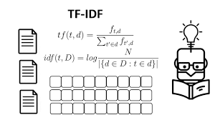
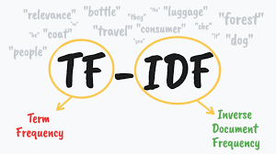
1. XGBoost With TF-IDF
TF-IDF Weights words by rarity across corpus to highlight key terms
XGBoost - Boosted decision trees, sequentially minimizing.
Weight: We applied TF-IDF to all the unigrams and bigrams.
Pros:
+ Easy to deploy as a single pipeline
+ No GPU needed
Cons:
Bag-of-words lacks deep semantic context
Long model training - large TF-IDF + areas

Slide 11
Packages
Do we need it?

Slide 12
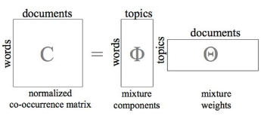
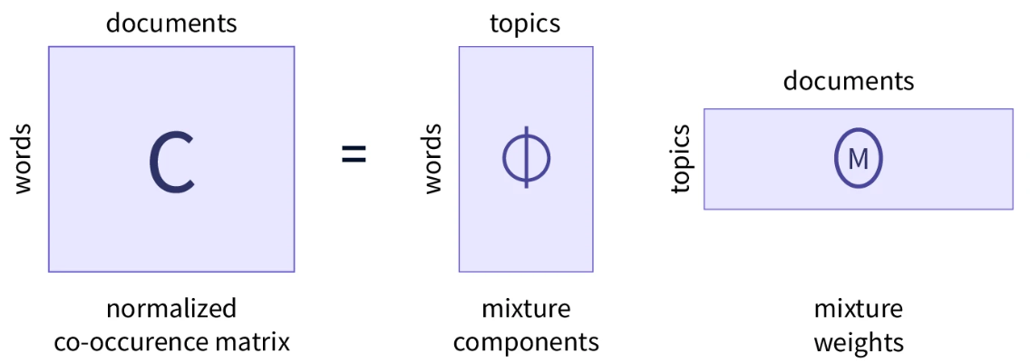
2. LDA - Latent Dirichlet allocation
Probabilistic topic modeling technique
Assumes documents are mixtures of topics
Each topic is a distribution over words.
Pros:
+ Provides interpretable topic structure
+ Good for exploratory analysis
Cons:
- Requires tuning (e.g., number of topics)
- Less accurate for fine-grained classification
Notes:
Use in this project:
Identify latent themes in abstracts
Use topic proportions as features for classification
notebook

Slide 13

Packages
Do we need it?

Slide 14

3. BERT - Bidirectional Encoder Representations from Transformers
Uses Transformer encoder only
Reads text bidirectionally
Learns with masked words and sentence pairs
Suitable for text classification
Pros:
+ State-of-the-art performance
+ Deep understanding of semantic context
Cons:
- Requires significant computational power
- Results are harder to interpret

Slide 15

Packages
Do we need it?

Slide 16
Results
Both Domain and area
For each model show both acc and f1
Graphs of comparison
Just graphs (do we need th? – if so AUC can fit here)

Slide 17
Results - Domain
F1 | Recall | Precision | Accuracy
0.89 | 0.89 | 0.90 | 0.89 | XGBoost With TF-IDF
 |  |  |  | LDA
 |  |  |  | BERT

Slide 18
Results - Area
F1 | Recall | Precision | Accuracy
0.80 | 0.80 | 0.81 | 0.80 | XGBoost With TF-IDF
 |  |  |  | LDA
 |  |  |  | BERT

Slide 19
Conclusions
/

Slide 20
Limitations
Class imbalance across 143 Area labels; minority recall suffers
Labels derived from manual curation → potential noise / inconsistencies
Abstract‑only input omits figures, citations, and full‑text context
Transformer models remain less interpretable than tree‑based models

Slide 21
Future Work
Leverage hierarchical label structure via HiBERT / TaxoBERT
Experiment with longer‑context models (Longformer, DeBERTa‑v3)
Integrate citation networks and author metadata for richer features

Slide 22
Thank you! Questions?

